Slide 1
McKinney-Vento Homeless Education Assistance Act
Susannah Wayland, Homeless Coordinator

Slide 2
Susannah Wayland
Homeless Coordinator
(614) 466-4161
Susannah.Wayland@education.ohio.gov

Slide 3
Right to a Free Public Education

Slide 4
McKinney-Vento Homeless Education Assistance Act

Slide 5
Who is homeless?
Individual who lacks a fixed, regular, and adequate nighttime residence
Includes children and youth

Slide 6
Who is homeless?
Sharing housing
Living in motels, hotels, trailer parks
Living in emergency or transitional housing
Abandoned in hospitals

Slide 7
How many students are homeless?

Slide 8
23,748

Slide 10
Where are they living?

Slide 12
Reauthorizes the McKinney Act (1987).
Requires educational access
Provides states with funding

Slide 13
McKinney-Vento Act

Slide 14
Liaison collaboration between social
service agencies and school districts
Restriction of the segregation of homeless
students

Slide 15
Enroll students experiencing homelessness immediately

Slide 16
Enroll Even
When Lacking Records
Proof of residency
Guardianship
Birth certificates, school records

Slide 17
Enroll Even
When Lacking Records
Birth certificates, school records
Medical records, including immunization
Required dress code items, including
uniforms

Slide 18
Enrollment

Slide 19
District Responsibilities
Remove barriers to enrolling homeless
students
Make school records available in a timely
manner

Slide 20
District Responsibilities
Provide comparable and coordinated services
Ensure that homeless students are not
segregated in separate schools or programs

Slide 21
District Liaison Responsibilities

Slide 22
Assist homeless students with immediate enrollment and attendance to school

Slide 23
Promote School and
Community Awareness
Training to school personnel
Disseminate public notices of rights
Coordinate with shelters, hotels, homeless serving agencies

Slide 24
Ensure
Identification

Slide 25
Data Collection
Collect information on homeless children and youth, including their places of residence
Include homeless students in statewide assessments

Slide 26
Data Collection
Method to collect local data and submit to state
EMIS

Slide 27
Transportation

Slide 28
Transportation
Share responsibility
Provide comparable service
Make arrangements
Coordinate with transportation directors

Slide 29
Board Policy

Slide 30
Ohio School Boards
Association
(614) 540-4000

Slide 31
Dispute Resolution

Slide 32
Title I Part A Set Aside
CCIP note # 78 June 29, 2006
Funds to provide services to homeless children who are not attending a participating Title I school

Slide 33
Serving Homeless Children and Youth Under Title I, Part A
An LEA may also use Title I, Part A funds to provide:
Educationally related services to homeless children and youth in shelters and other locations where they may live.

Slide 34
Serving Homeless Children and Youth Under Title I, Part A
Services that may not ordinarily be provided to other students.
For Example:
Items of clothing, particularly if necessary to meet a school’s dress or uniform requirement
Clothing and shoes necessary to participate in physical education classes.

Slide 35
Serving Homeless Children and Youth Under title I, Part A
Examples: (cont.)
Student fees that are necessary to participate in the general education program
Personal school supplies such as backpacks and notebooks.
Birth certificates necessary to enroll
Immunizations
Other examples listed in G-11 of Title I Use of Funds

Slide 36
New Authority
Provided further, that funds available under sections 1124,1124A, 1125 and 1125A of the ESEA may be used to provide homeless children and youths with services not ordinarily provided to other students under those sections, including supporting liaisons designated pursuant to section 722(g)(1)(J)(ii) of the McKinney-Vento Homeless Assistance Act, and providing transportation 722(g)(1)(J)(iii)of such Act.

Slide 37
New Authority
The 2014 appropriations act expands the use of Title I funds to support homeless children and youth for the following requirements under McKinney-Vento:
Local homeless liaisons
Transportation to and from the school of origin.

Slide 38
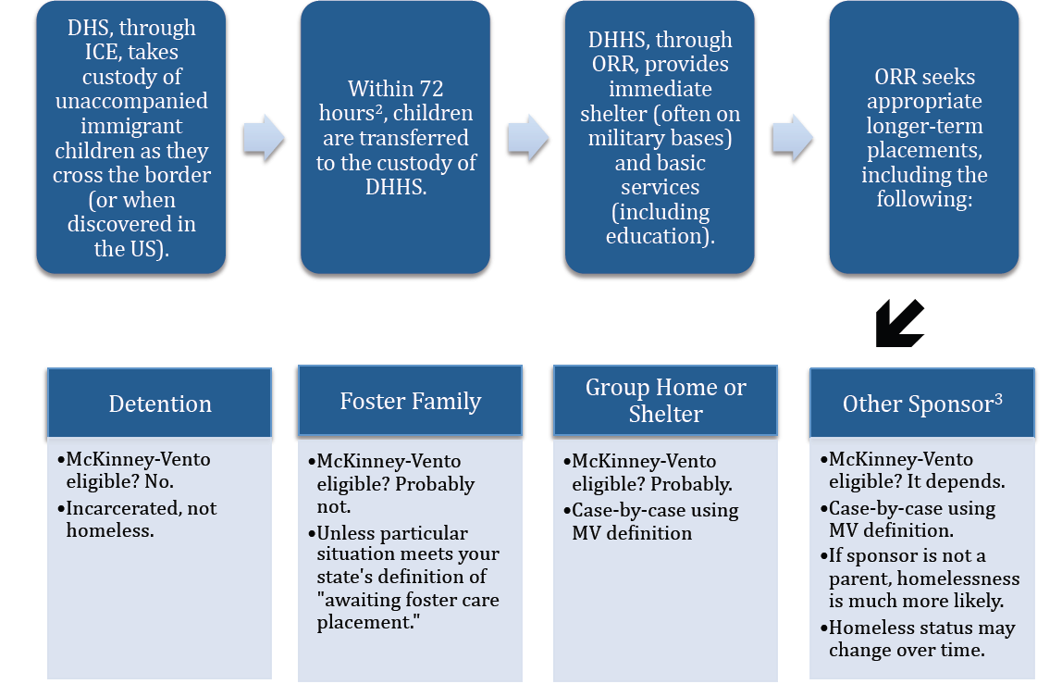
Unaccompanied Immigrant Children
Notes:
DHS: Department of Homeland Security, the Federal agency that oversees immigration law and enforcement.
ICE: Immigration and Customs Enforcement, the subdivision of DHS that handles immigration investigations and enforcement and takes unaccompanied immigrant children into custody. Includes (Homeland Security Investigations) and ERO (Enforcement and Removal Operations).
DHHS: Department of Health and Human Services, the Federal agency that takes custody of and provides services to unacompanied immigrant children as the await adjudication.
ORR: Office of Refugee and Resettlement, a subdivision of DHHS with the responsibility to provide for the custody, care and placement of unaccompanied immigrant children until their immigration case is completed.

Slide 39
Program Audit and Compliance Tracking System
Self evaluation
Telephone survey
On-site review

Slide 40
Tips for Identifying
Homeless Children and Youth

Slide 41
Know your community “network”

Slide 42
Train school enrollment personnel to:
Look for signs
Offer assistance
Contact you

Slide 43
Possible Signs of Homelessness
Attendance at several schools
More than one family at the same address Attention-seeking behavior

Slide 44
Possible Signs of Homelessness
Hunger and hoarding of food
Poor hygiene and grooming
Sleeping in class

Slide 45
Susannah Wayland
Homeless Coordinator
(614) 466-4161
Susannah.Wayland@education.ohio.gov

Slide 46
For More
Information
education.ohio.gov

Slide 47
education.ohio.gov

Slide 48
Social Media
Ohio Families and Education
Ohio Teachers’ Homeroom
ohio-department-of-education
storify.com/ohioEdDept
@OHEducation
OhioEdDept

